Slide 1


Slide 2
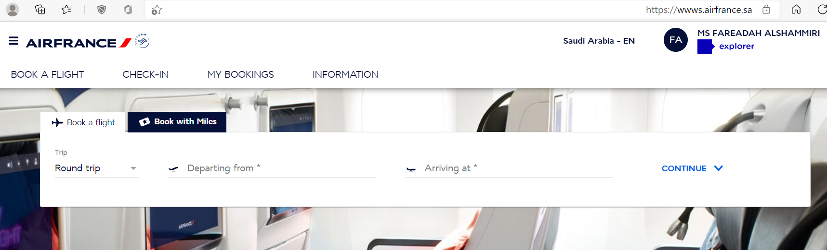
A site with a special and easy domain that expresses the content of the business and distinguishes the company.
https://wwws.airfrance.sa/ and Easy to read and User Friendly site.

Slide 3
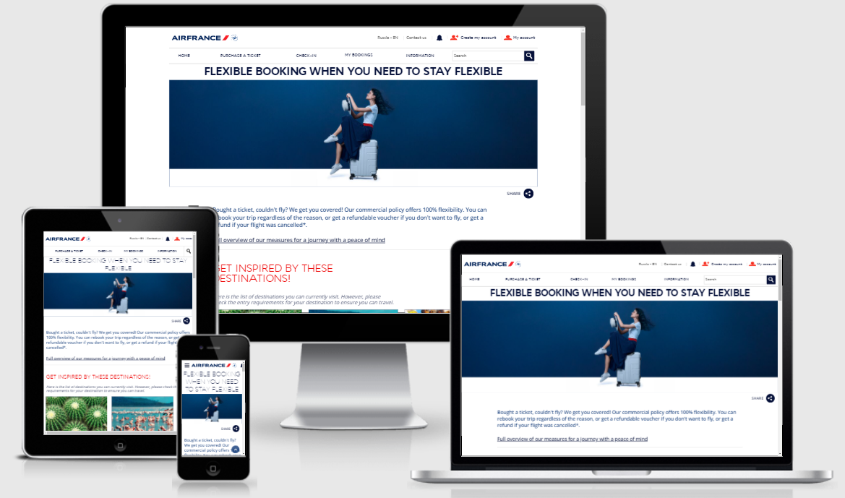
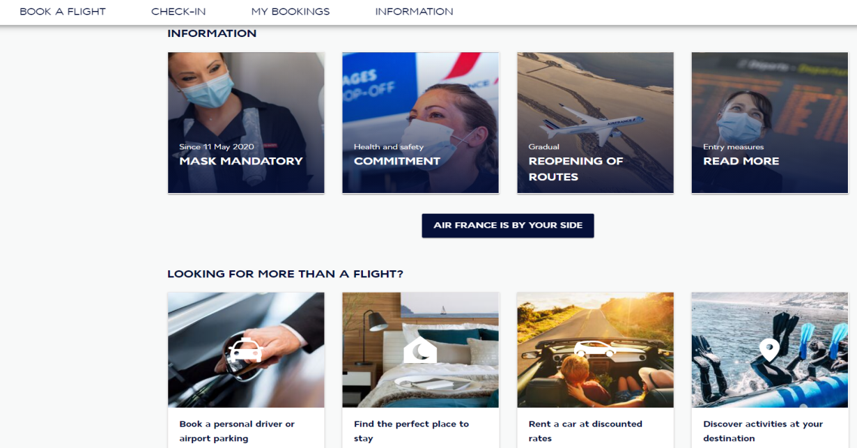
Browsable on any screen or Responsive device.
It has a good layout and division of tabs and sections.
It has an attractive and distinctive design, the image of which takes into account the specifics of the target audience.
The website colors reflect the visual identity of the trademark.

Slide 4
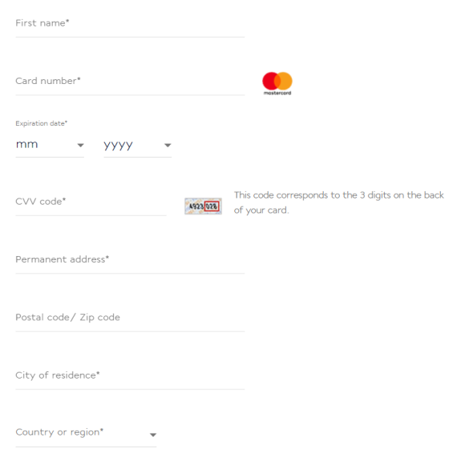
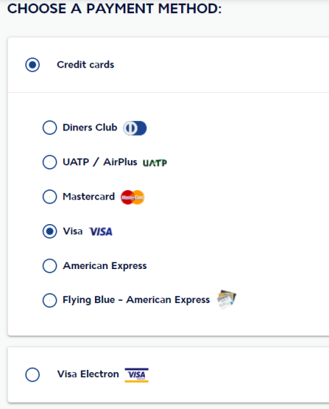
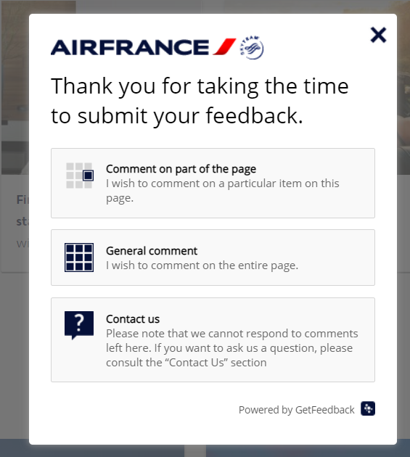
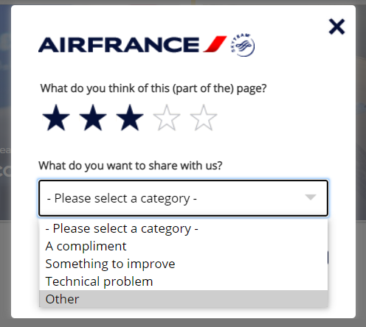
Uses the easy-to-use and understandable Checkout payment page.
It has a special section for notes that they allocate a dedicated complaints room, where the customer sends his complaints directly through a special channel or by referring to the department that he wants to send his notes to him.

Slide 5
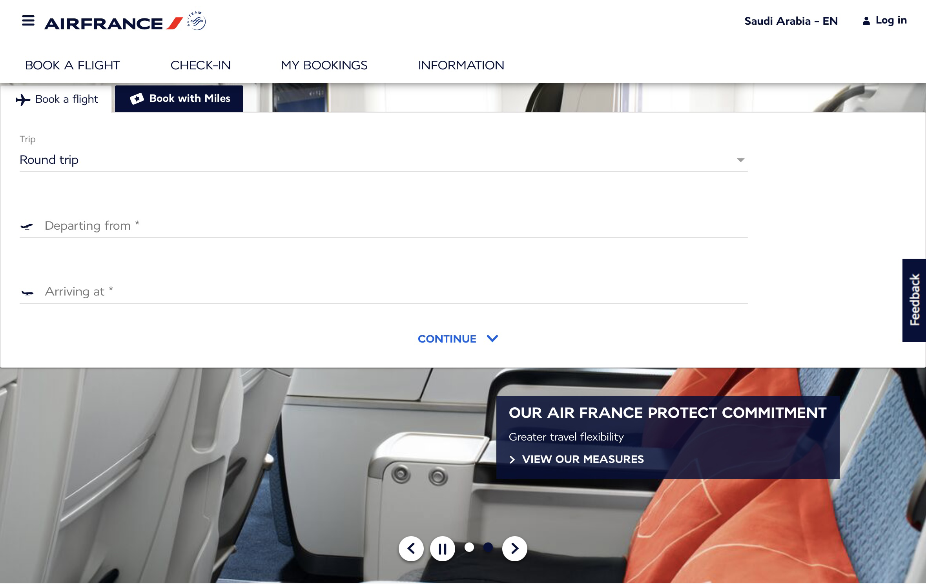
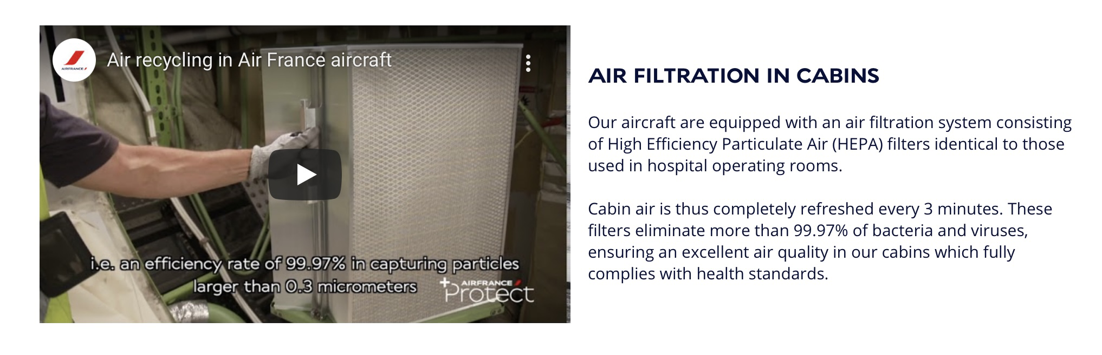
The main page contains an introductory video

Slide 6
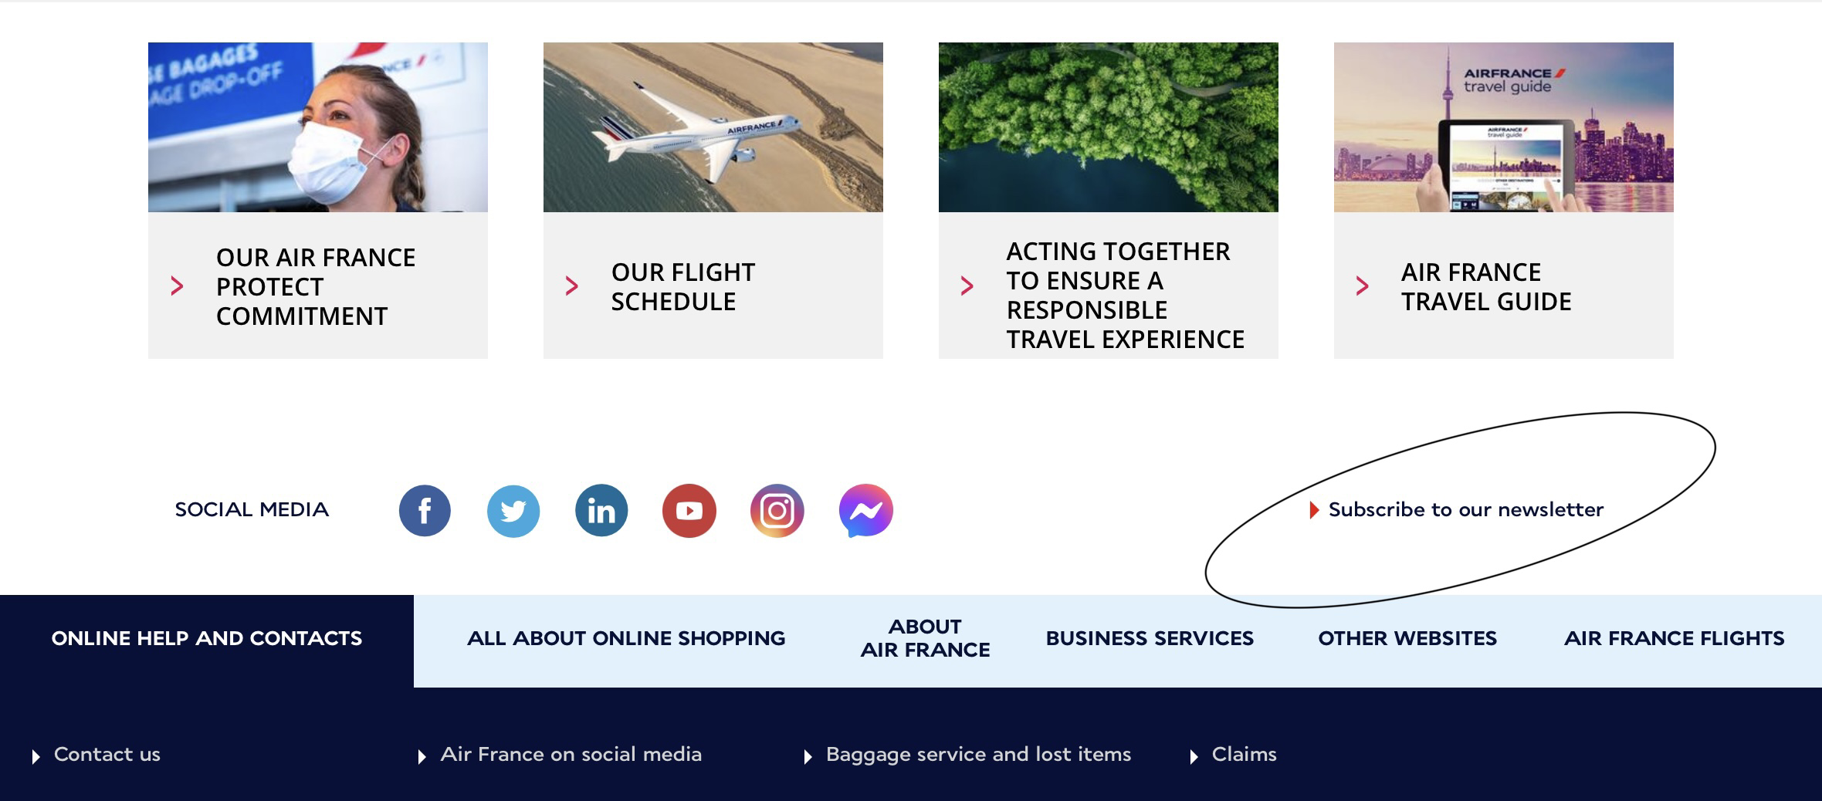
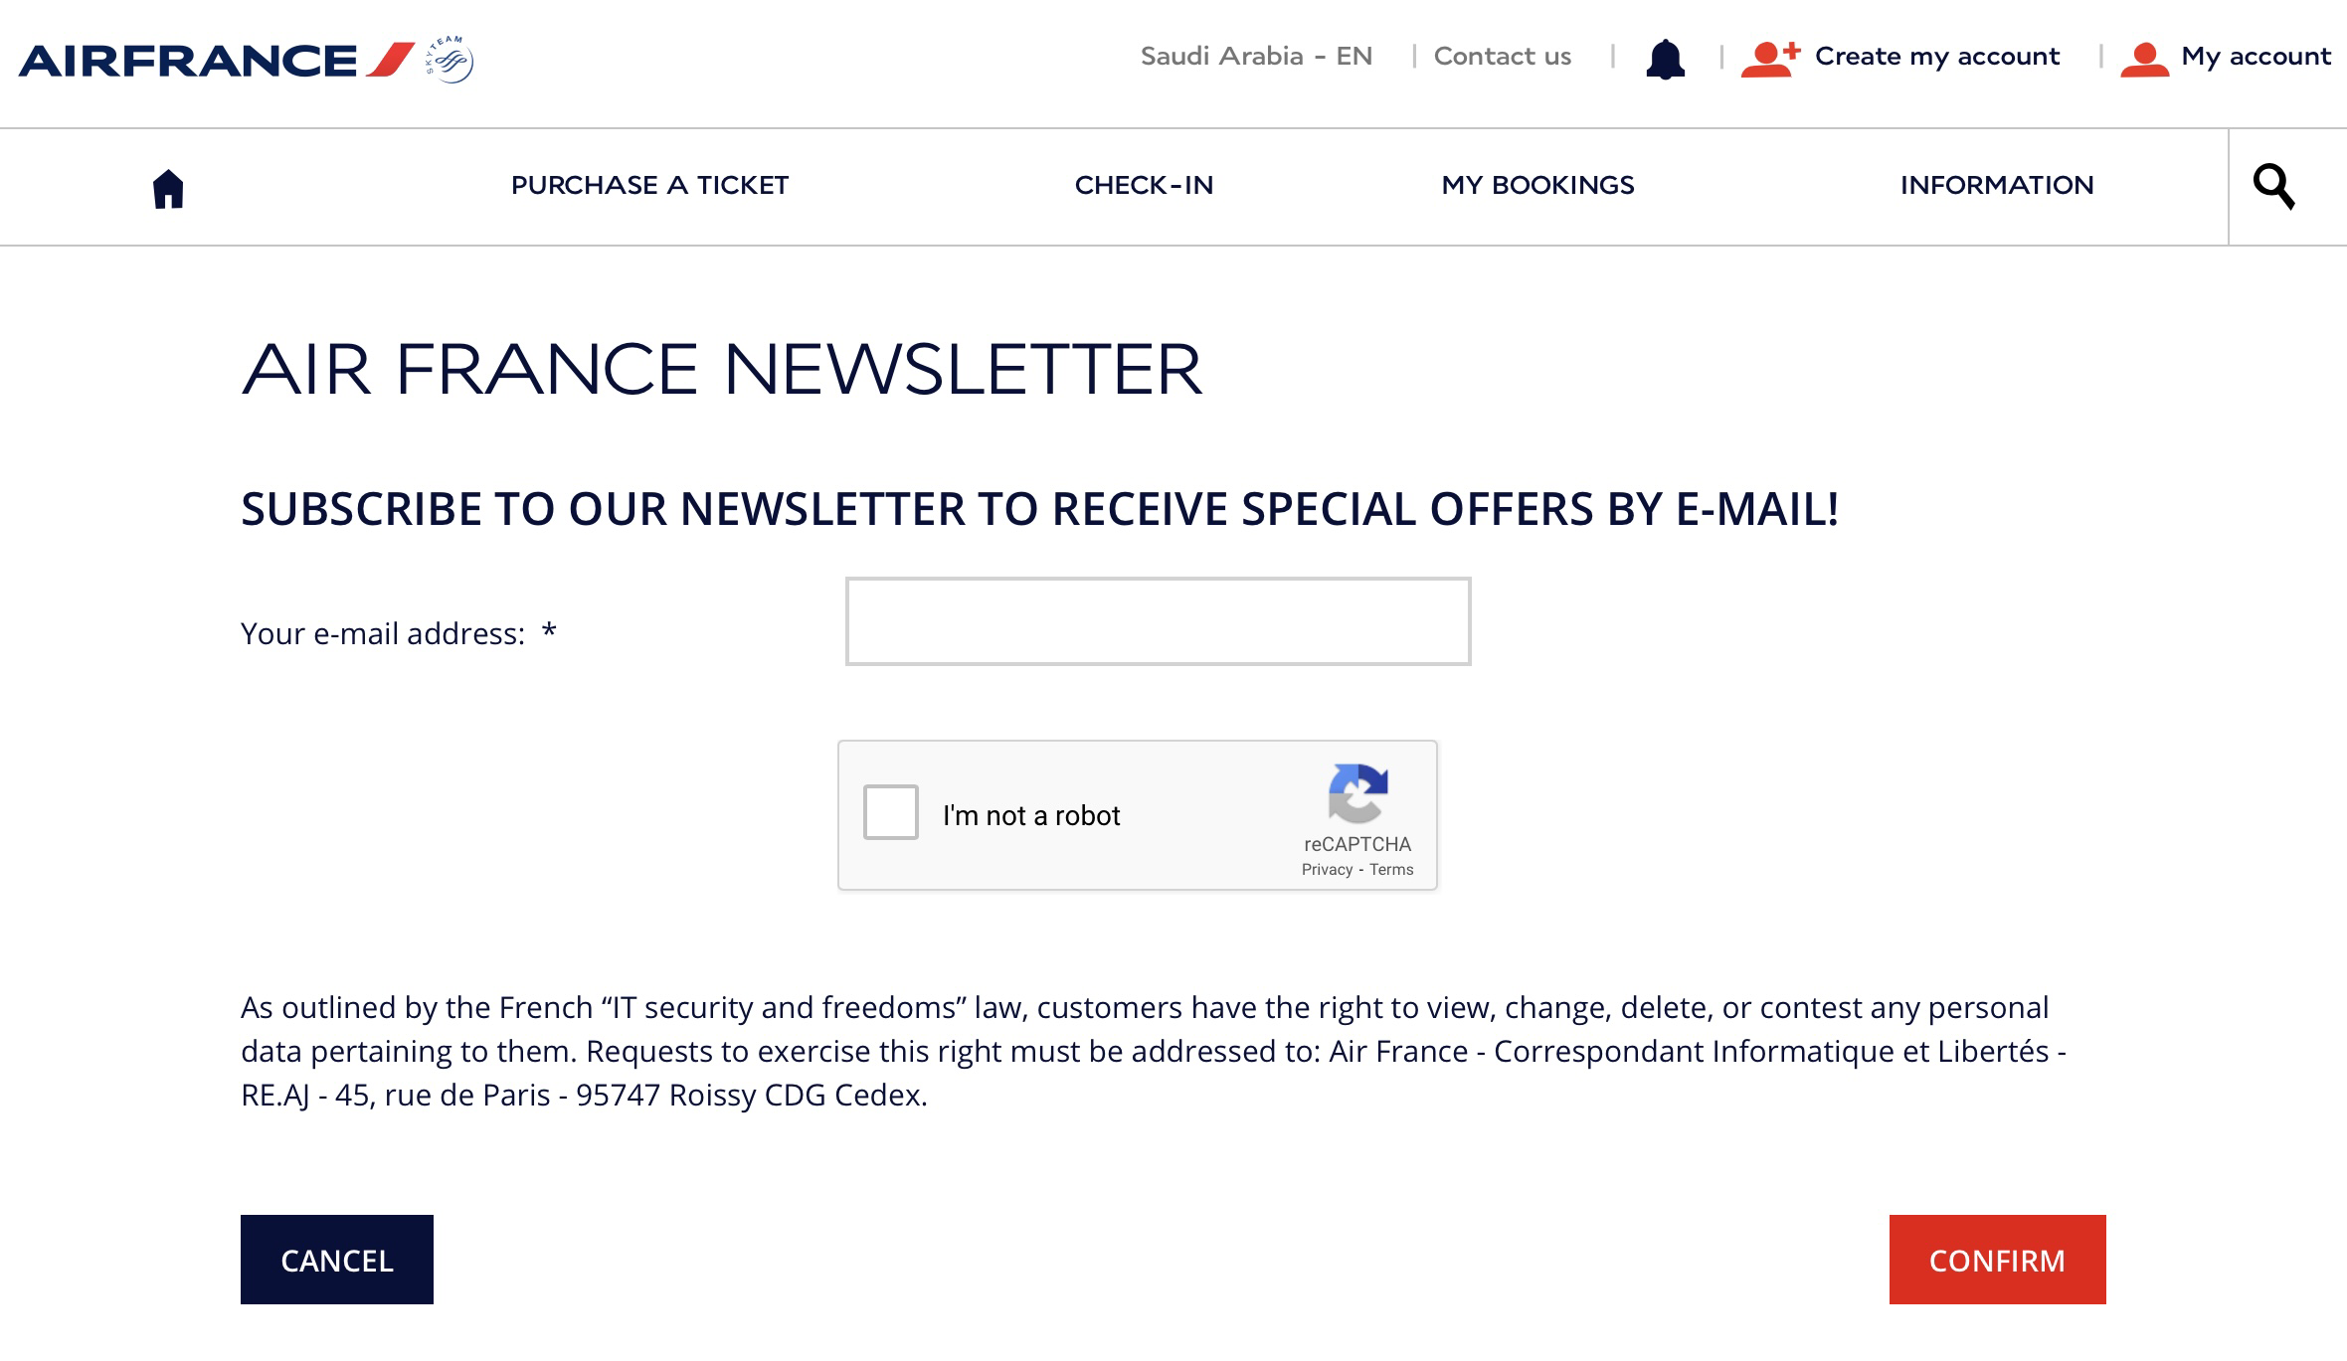
The website includes a box to subscribe to the newsletter

Slide 7

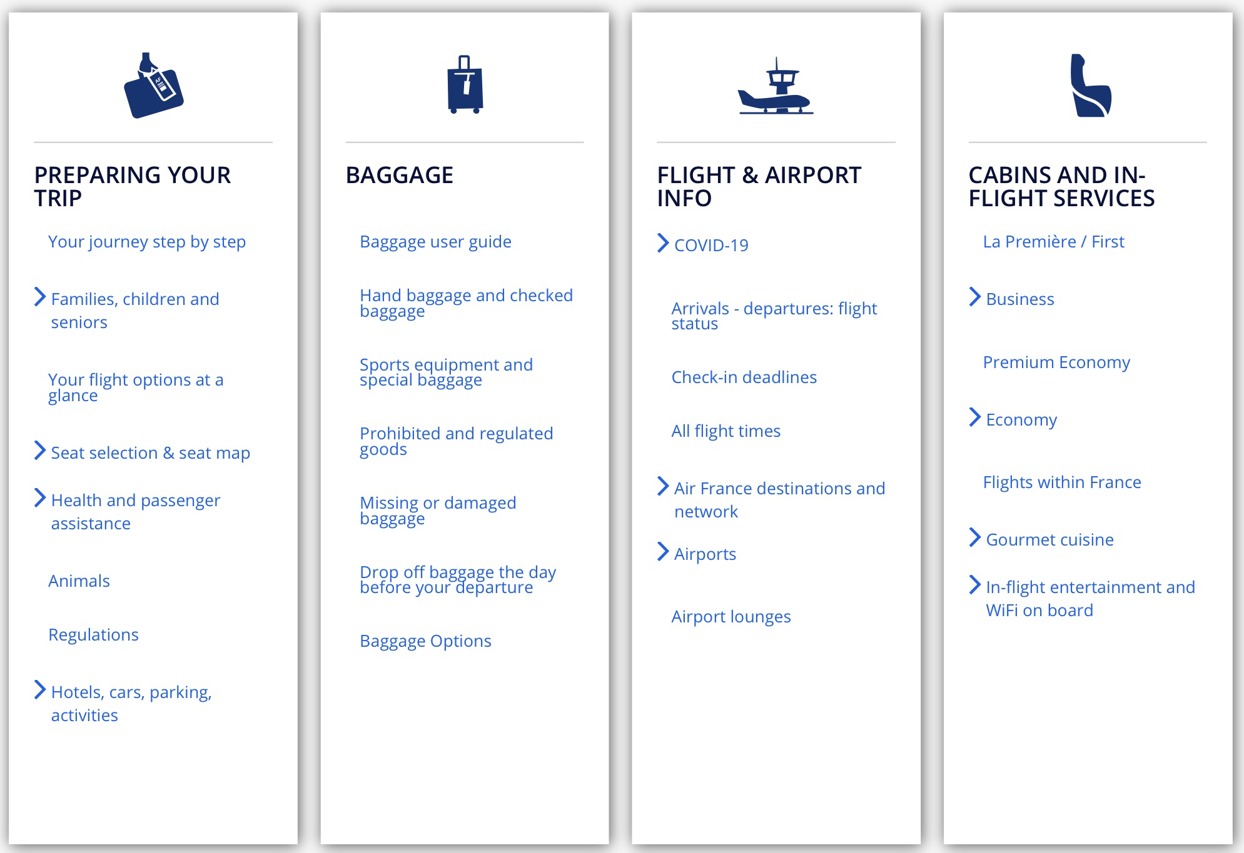
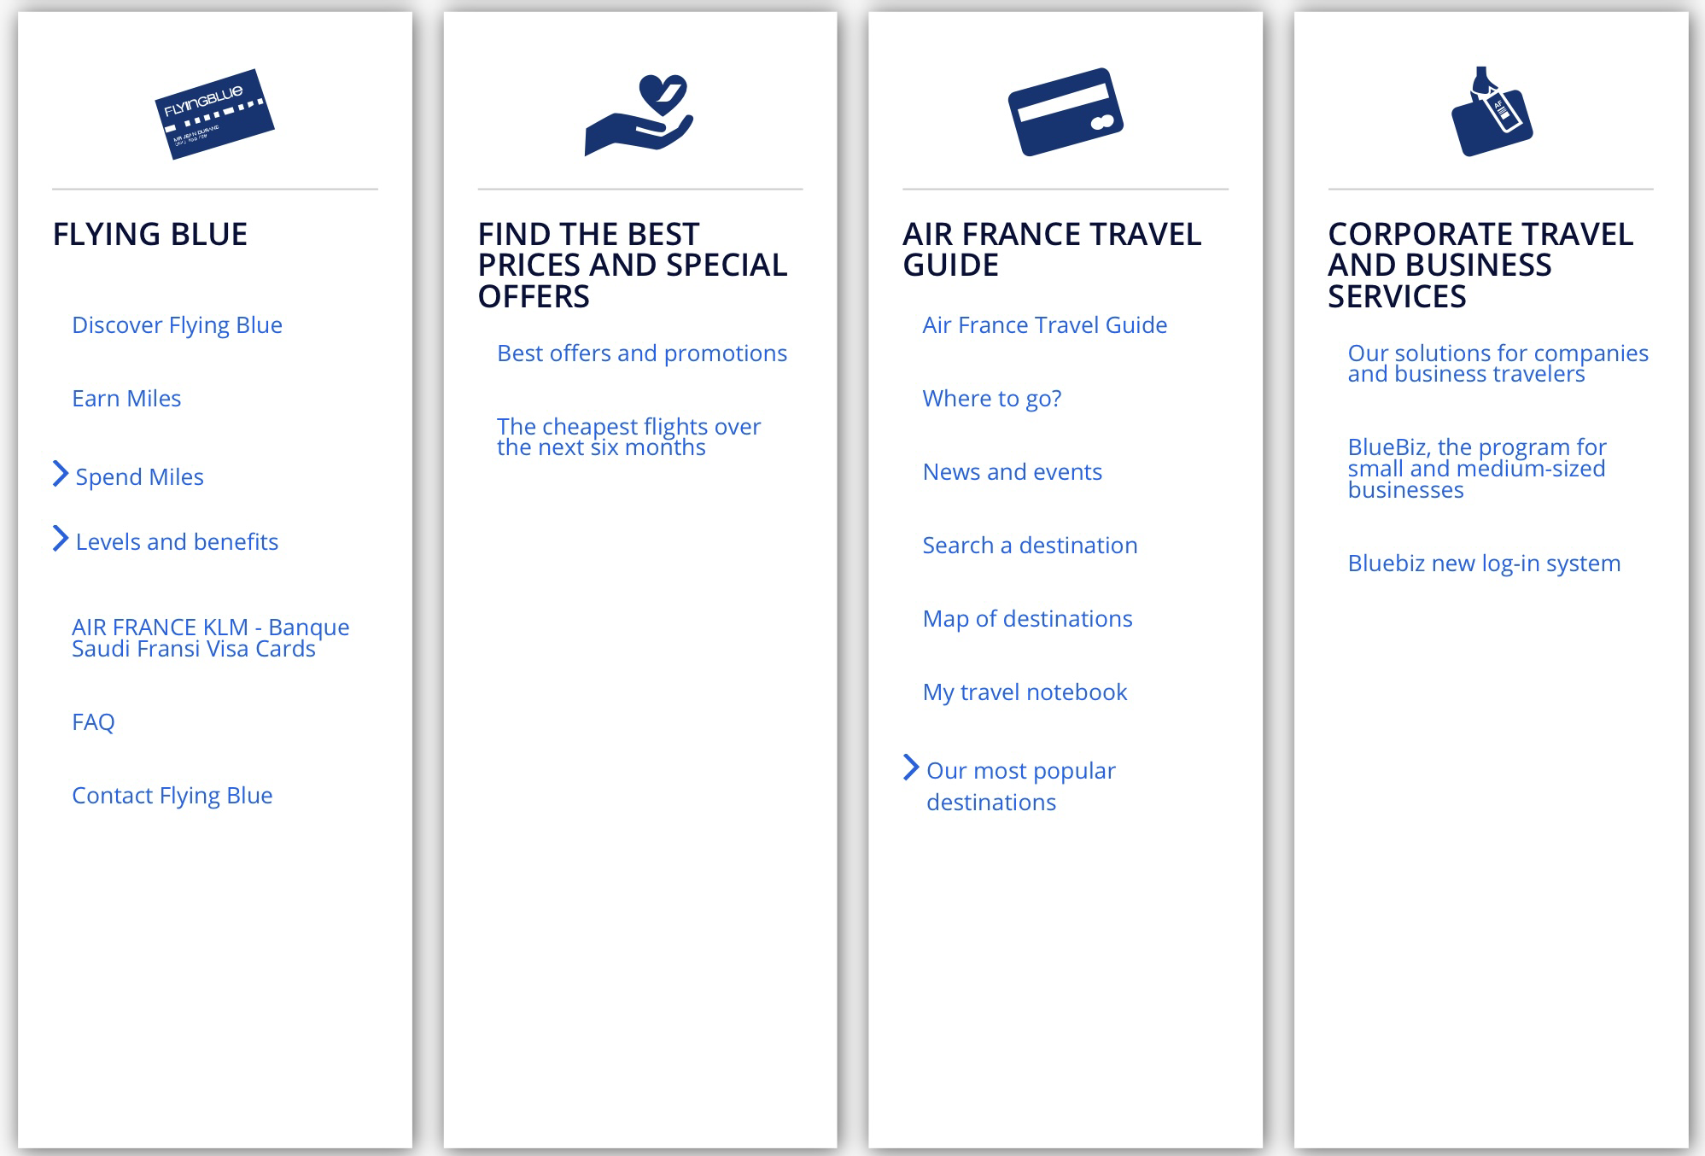
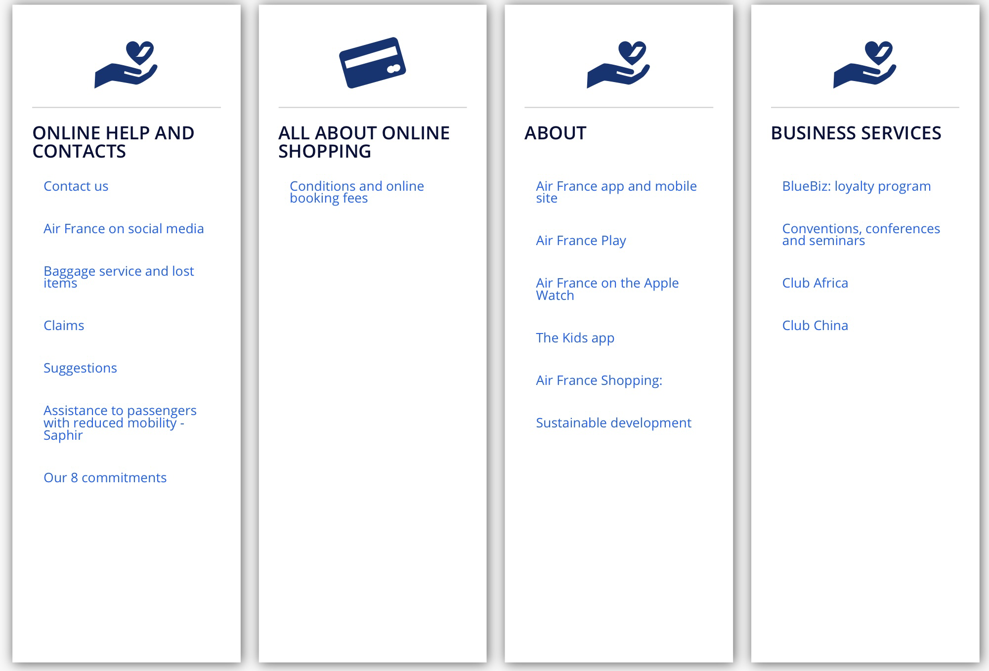
Site map

Slide 8
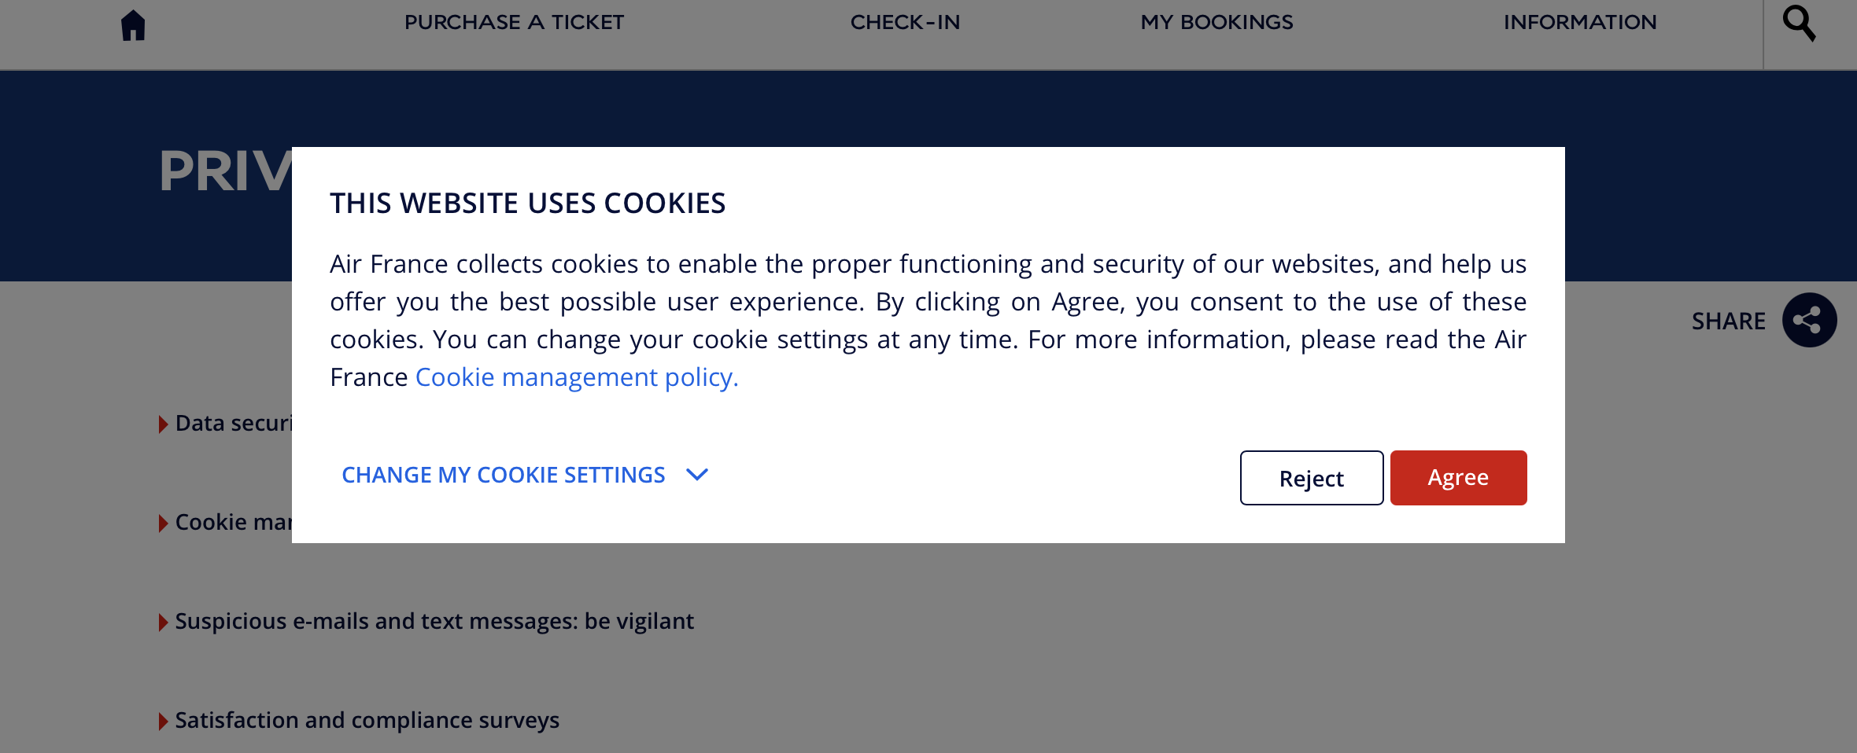
Website use cookies
When you visit a website that uses cookies, a cookie file is saved to your PC, Mac, phone or tablet. It stores the website's name, and also a unique ID that represents you as a user. ... This means companies can tailor their websites to you, because they know some information about you already.

Slide 9
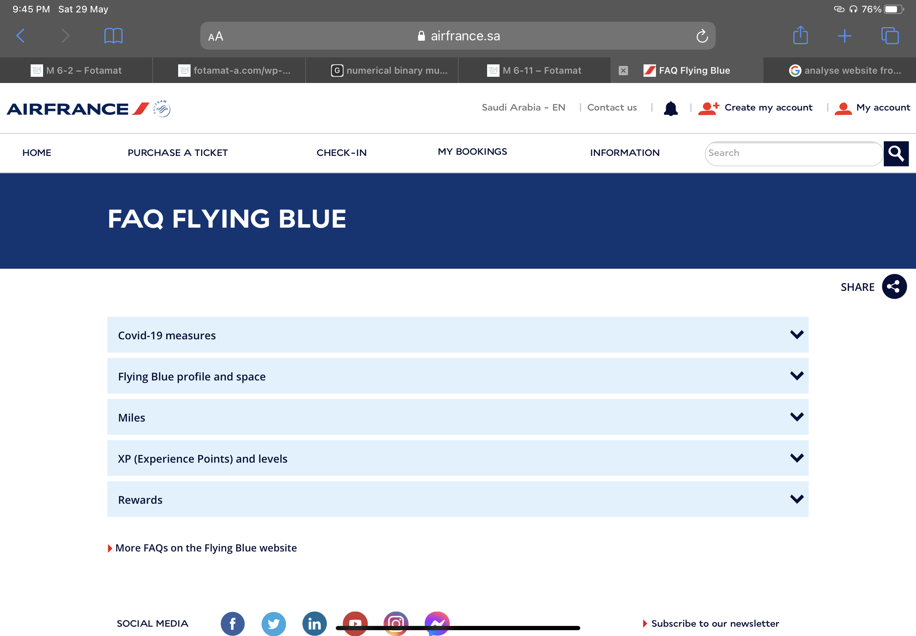
Frequently Asked Questions
Save you time
Build relationships with customers
Identify you as an expert
Improve site navigation
Improve search engine listings
Turn negatives into positives
Highlight key information
Analyze your site

Slide 10
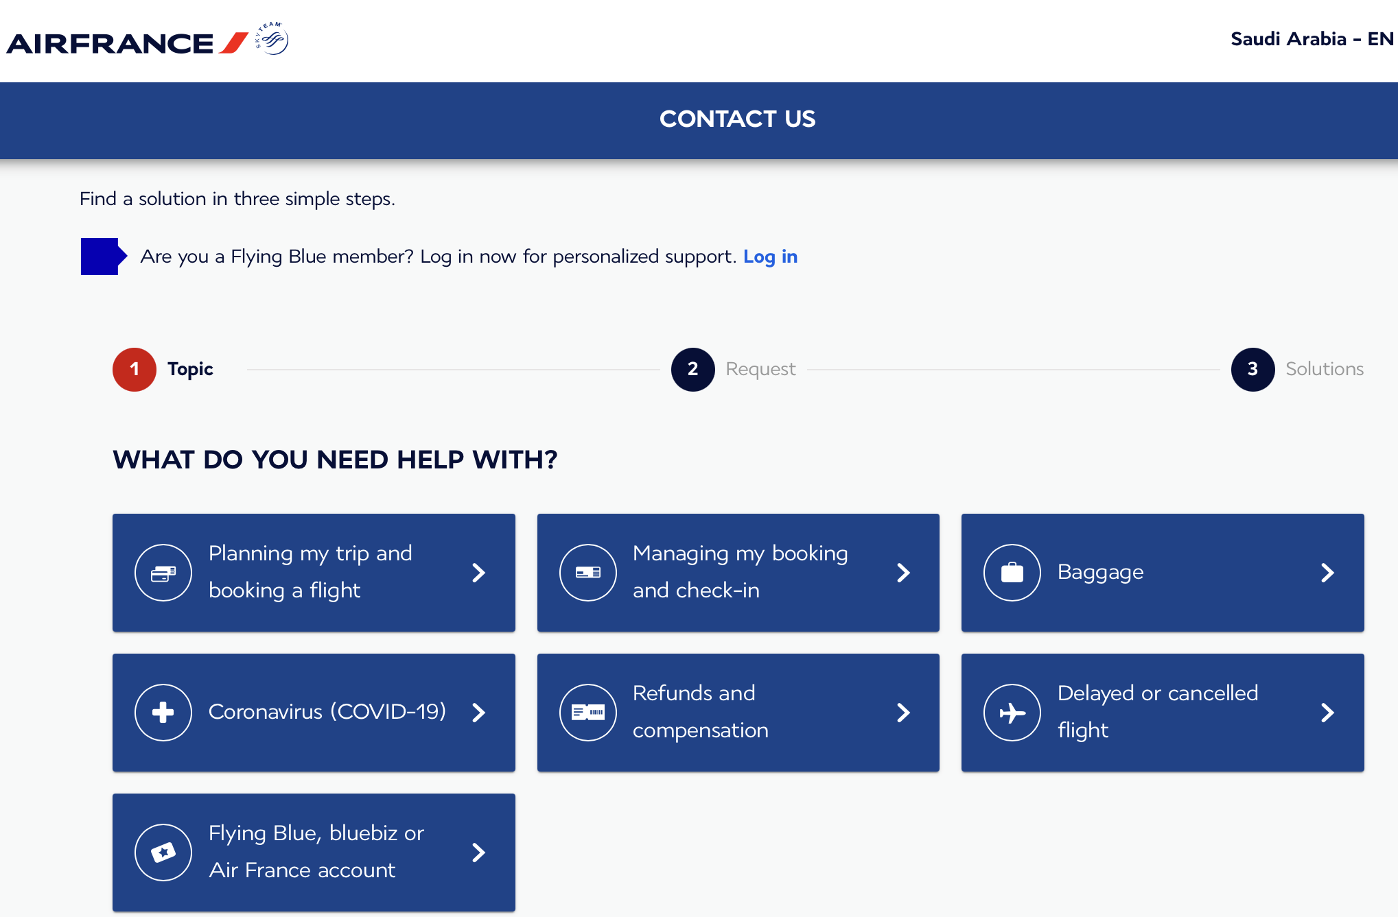
Communicate with the support team

